Slide 1


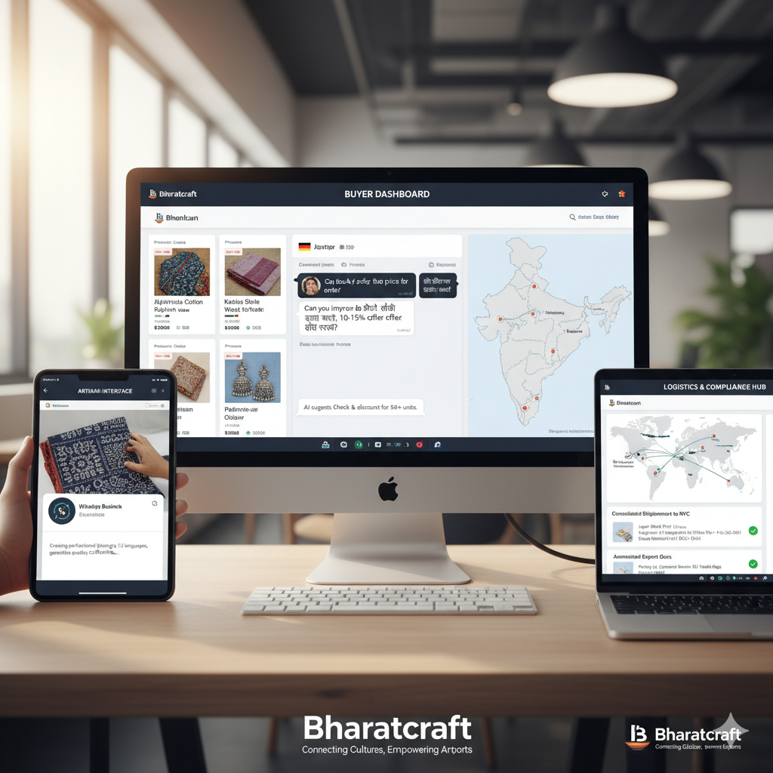
Bharatcraft
AI-Powered Export Marketplace for Artisan Clusters
Empowering 7 Million Artisans to Reach Global Markets
TechGig Hackathon 2025
Make in India for the World: Driving Economic Resilience

Slide 2

The Artisan Crisis
Millions of skilled artisans are trapped in an ecosystem of exploitation.
Where the Money Goes
7M
Artisans Earning Below Minimum Wage
Artisan Creates
12-18%
4-7
Intermediaries in Supply Chain
Middlemen (Traders, Exporters)
29-45%
20-40%
Margins Taken by Middlemen
Retailer
40-50%
12-18%
Of Retail Price Reaches Artisans
Artisans create the value but receive the smallest share.
02 | Problem Statement

Slide 3



The Bharatcraft Solution
AI-Powered Marketplace Connecting Artisans Directly with Global Buyers
Eliminating intermediaries, maximizing artisan income, preserving cultural heritage
Traditional Model Bharatcraft Model
Artisan
₹100
Artisan
₹100
Direct Connection via AI Platform
Local Trader / Distributor
-₹80
Bharatcraft Platform
7-10% platform fee
AI Negotiation
Quality Grading
Exporter
-₹70
Logistics Pooling
Export Compliance
Direct Export
Global Retailer
₹800
Global Buyer
₹600
Artisan receives only 12.5% of final retail price
Artisan receives 70-75% of sale price (3-5x increase)
03 | Solution Overview

Slide 4







Feature 1: Cultural Context AI Negotiation
AI-Powered Cross-Cultural Negotiation
GPT-4 engine for culturally-aware negotiation and fair price determination.
How It Works
Buyer Inquiry
A global buyer expresses interest in an artisan's product.
Web Platform / Mobile PWA
1
Multilingual Support
Communicates in 15+ languages (Hindi, Tamil, etc.)
Context Understanding
AI analyzes product details, artisan costs, and market rates.
GPT-4 | Market Data API
Cultural Intelligence
Understands regional negotiation styles and customs.
2
Fair Pricing
Ensures artisans get 70-75% of sale price vs. 12-18% traditionally.
Multilingual Negotiation
AI facilitates real-time, culturally-aware conversation.
Real-time Translation | Cultural Context Engine
3
Exploitation Prevention
AI detects and blocks unfair pricing offers.
Price Recommendation
AI suggests a fair price range, ensuring artisans get 70%+ of value.
Pricing Algorithm | Historical Data
4
Smart Contract
Terms are locked on the blockchain, guaranteeing payment.
Blockchain | Smart Contracts
5
Tech Stack: GPT-4 | Fine-tuning | Real-time Translation
04 | Core Features

Slide 5











Feature 2: Computer Vision Quality Grading & Export Compliance
AI-Powered Quality Assurance
AI-driven vision system to auto-grade quality, detect defects, and generate export documents.
System Architecture
Input Layer
Mobile App Camera
Artisan captures photos
Web Upload
Bulk upload interface
98.5%
Detection Accuracy
<2 sec
Processing Time
100%
Doc. Coverage
Processing Layer
YOLOv8 Object Detection
PyTorch | CUDA | OpenCV
Product ID, defect detection, measurements
Defect Detection
Identifies cracks, color inconsistencies & dimension issues.
Quality Classification
CNN | Transfer Learning
Color, texture & pattern recognition
Quality Grading
A/B/C grading based on 20+ quality parameters.
Auto Documentation
Generates export certificates, quality reports & customs forms.
AI Decision Layer
Compliance Checker
Validates against 50+ country-specific import regulations.
Grading
A/B/C
Compliance
Export OK
Docs
Certs
Output Layer
MongoDB
Quality data, reports
FastAPI
REST API
YOLOv8 | PyTorch | OpenCV | FastAPI | MongoDB
05 | Core Features

Slide 6











Feature 3: Cluster Logistics Pooling
Smart Consolidation for Cost Efficiency
Our AI pools shipments from artisans within a 50km radius, coordinating pickups and consolidating items into single export shipments to slash costs.
60-75%
Reduction in Shipping Costs
50km
Cluster Radius
10-50
Artisans per Cluster
Pooling Process Workflow
1. Order Matching
AI identifies orders for the same destination region.
2. Artisan Notification
SMS/App alerts sent to cluster members for pickup.
3. Consolidated Pickup
A single vehicle collects items from all artisans.
4. Processing Hub
Items are professionally packaged for export.
5. Export Shipment
A single international shipment is dispatched.
Neo4j Graph DB
Notification Service
Route Optimization AI
Hub Management
Logistics Partners
Result: 60-75% cost reduction makes exports profitable for artisans with orders as small as $50
06 | Core Features

Slide 7






Technical Architecture
Scalable, AI-First, Decentralized Platform
A microservices architecture for performance, scalability, and trust.
Frontend Layer
API & Orchestration Layer
React PWA
Next.js 14 | TypeScript
Artisan dashboard
Order management
Offline-first
Buyer Web Portal
React | Redux
Product discovery
AI negotiation
Order tracking
API Gateway
Kong | Rate Limiting
Central entry point, request routing, auth
Backend Services
Python FastAPI | Microservices
User
Product
Order
Payment
AI & ML Services Layer
Data Layer
GPT-4 Negotiation
OpenAI API
Multilingual translation
Price recommendation
Computer Vision
YOLOv8 | PyTorch
Quality grading
Defect detection
Measurements
Logistics Optimizer
OR-Tools | Neo4j
Route optimization
Cost calculation
MongoDB
Purpose: Primary database
Data: Users, Products, Orders, Reports
Neo4j Graph DB
Purpose: Relationship mapping
Data: Supply chain, Logistics routes
Redis Cache
Purpose: Performance optimization
Data: Session data, API responses
Sharded cluster for scaling
Graph queries <100ms
Sub-millisecond latency
Blockchain & Security
Infrastructure & DevOps
Smart Contracts
Solidity | Polygon
Payment escrow
Order verification
Audit trail
Security Services
JWT | OAuth 2.0
Authentication
Authorization
Data encryption
Cloud Infrastructure
AWS | Docker | K8s
Auto-scaling
Load balancing
CI/CD pipeline
External Integrations
Payment gateways
Logistics APIs
SMS/Email services
Why: Immutable & trustless transactions
Microservices for independent scaling
Multi-database strategy for performance
AI-first with GPT-4 and YOLOv8
Blockchain for trust and transparency
07 | Technical Architecture

Slide 8
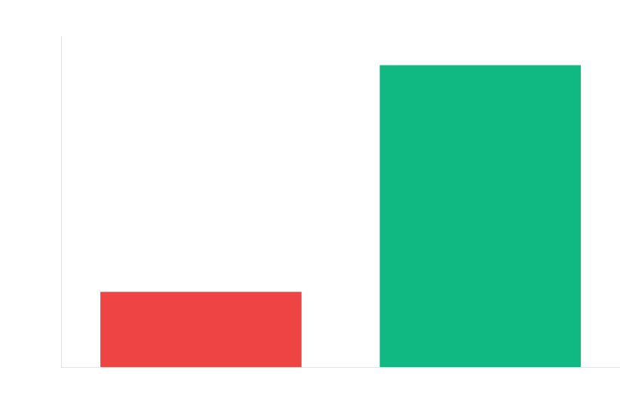


Impact & Growth Metrics
Transforming Lives Through Direct Market Access
Projected first-year impact and growth trajectory
$2M
Projected Exports Year 1
Target
500+
Artisans Onboarded
First 6 months
15
Countries Reached
Global presence
2,500
Orders Fulfilled
Year 1 projection
4x earnings increase
08 | Impact Metrics

Slide 9









Revenue Model & Market Opportunity
Sustainable Revenue Model Market Opportunity
$18B
Global Ethical Handicrafts Market
8.5% CAGR
North America
$6.2B
High demand for authentic crafts.
Europe
$7.8B
Strong ethical consumption trend.
Asia-Pacific
$2.5B
Emerging premium segment.
Rest of World
$1.5B
Growing global awareness.
Platform Fee: 7-10% of transaction value
AI Negotiation
2%
Quality Grading & Compliance
2%
Current Indian Export: $3.5B annually Our Potential: $15-20M in Year 3
Logistics Coordination
2%
Payment Processing & Security
1-3%
Why This Scales
75% lower than traditional middlemen (25-40%)
Network effects: More artisans attract more buyers.
AI improves with data, enhancing matching & pricing.
Additional Revenue Streams:
Premium Artisan Analytics Training & Certification Programs White-Label B2B Solutions
Low marginal cost allows for infinite software scaling.
7M+ addressable artisan market in India.
09 | Business Model

Slide 10
Empowering Artisans, Preserving Heritage
Technology Meets Tradition for Global Impact
What We Deliver
4x Earnings Increase
Artisans earn 70-75% vs 12-18%
AI-Powered Platform
GPT-4 negotiation, YOLOv8 quality grading
Direct Market Access
Eliminate 4-7 intermediaries
$18B Market
Massive scalability potential
Blockchain Trust
Transparent, secure transactions
Smart Logistics
60-75% shipping cost reduction
Our Vision
To build India's largest artisan export ecosystem, onboarding 50,000 artisans and generating $50M in exports by 2028.
Make in India for the World — One Artisan at a Time
Join Us in Transforming 7 Million Lives
TechGig Hackathon 2025: Make in India for the World
Bharatcraft
AI-Powered Export Marketplace for Artisan Clusters team@bharatcraft.ai

